Slide 1
Smart Home Energy Management System
SWETHA PALLEY

Slide 2
What is SHEMS?
A modern, technology-driven solution designed to efficiently monitor, control, and optimize electrical energy consumption within a smart home.
Key Capabilities:
Tracks real-time energy usage.
Reduces energy wastage and improves convenience.
Uses network-connected devices, automation rules, and analytics.

Slide 3
Proposed Solution
Key Features of the Proposed System:
Centralized Control: Unified management of all smart devices.
Real-Time Monitoring: Live tracking of energy consumption.
Automated Scheduling: Automatic device control based on preset schedules.
Analytics Dashboard: Visual insights into consumption patterns.
Enhanced Security: Secured access using Authentication and Role-Based Authorization.

Slide 4
System Configuration (Tech Stack)
Backend Technologies:
Language: Java 21
Frameworks: Spring Boot, Spring MVC
Security: Spring Security (JWT Authorization)
ORM: Hibernate/JPA (No manual SQL queries)
API: RESTful Web Services
Frontend Technologies:
HTML5 & CSS
ReactJS
Database & Tools:
MySQL Database & MySQL Workbench
IntelliJ IDEA Community Edition
Postman (API Testing) & GitHub (Version Control)

Slide 5
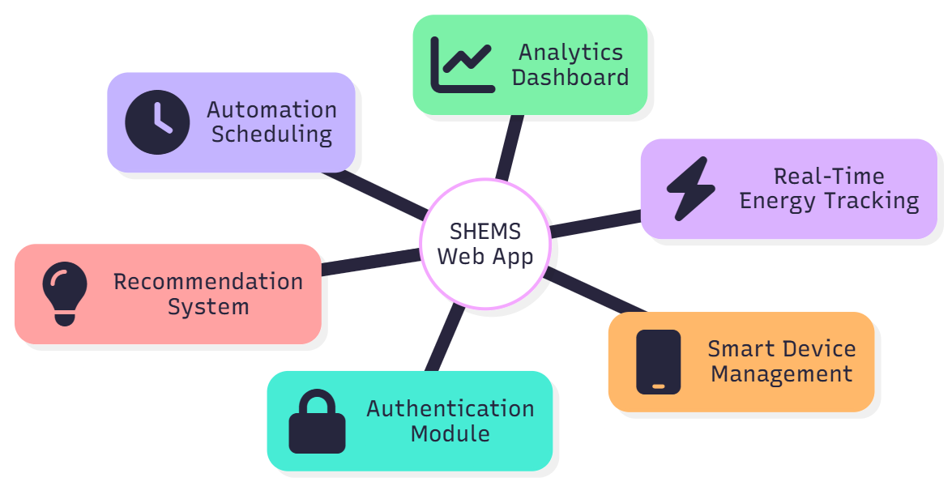
Project Modules
Authentication & Role Management: Secure login, registration, and role-based access.
Smart Device Management: Adding, updating, and removing devices; status control.
Real-Time Energy Tracking: Live monitoring of energy for each device.
Analytics Dashboard: Charts and graphs showing peak hours and consumption trends.
Automation Scheduling: Automatic ON/OFF control based on rules.
Recommendation System: Smart suggestions to optimize usage .

Slide 6
Module 1 - Authentication & Role Management
Objective: To provide a secure entry point for the application using encryption and token-based authorization.
Key Activities:
User Registration & Login.
Password Encryption.
JWT (JSON Web Token) generation and validation.
Role-based screen access (Admin vs. User).

Slide 7
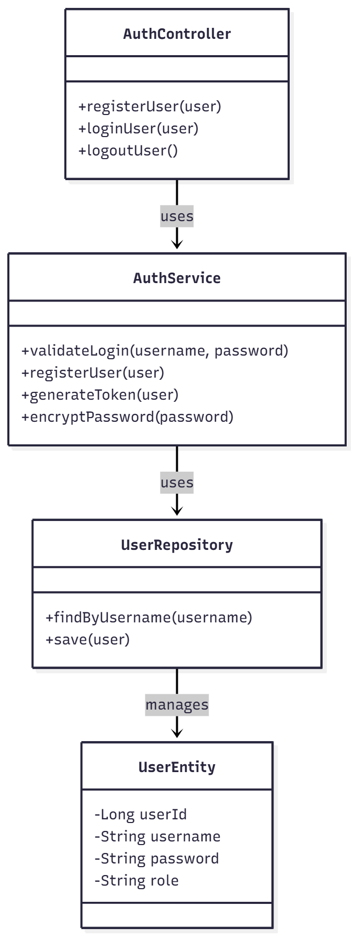
Module 1 - Technical Implementation (Classes)
User (Entity Class):
  Stores user profile details (username, password, name).
  Contains role information used for authorization.
AuthController:
  Exposes REST APIs for login and registration.
  Acts as the bridge between the Frontend and the Backend Service layer.
AuthService:
  Handles core business logic.
  Validates login credentials and encrypts passwords.
  Generates and validates JWT tokens.
UserRepository:
  Communicates directly with the MySQL database using JPA.
  Methods include finding users by username and saving records.

Slide 8
MODULE 2 - Smart Device Management
Primary Goal: To digitize physical appliances into manageable software entities.
Key Features:
Device Registration: Users can add devices (e.g., "Living Room AC").
Status Toggling: Switch devices ON or OFF remotely.
Attribute Management: Update power ratings (Wattage) and location.
Inventory List: View all connected devices in a grid layout.

Slide 9
THANK YOU

